Slide 1
Arizona Housing Price Prediction
Kellie Halladay and Paulo Barrera

Slide 2
Problem
Housing Market is a big topic of discussion
Rising prices; Inability to afford homes
Housing price trends have been researched for years
Can we predict housing costs based on the relevant factors?
location, size, number of beds/baths, garage, age of the house, distance to a school/grocery store, population, home value index, and date
Can we predict future housing costs?
Utilize time series data to find patterns in housing costs over the years

Slide 3
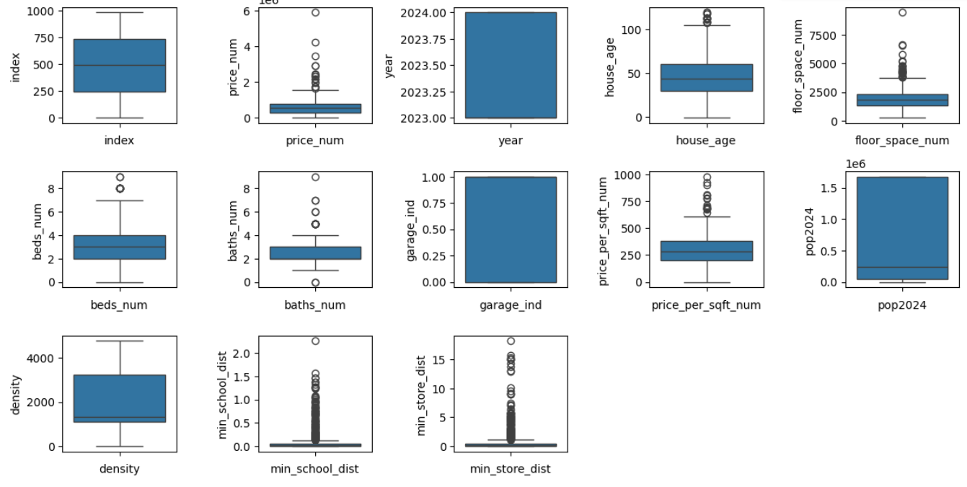
Spatial Data - Exploratory Analysis
Computed minimum distances between each Trulia listing and a school/store
Merged Arizona population dataset with Trulia data
Removed outliers
from dataset (i.e.,
prices over $10
million, more than
10K square feet)
Examined variable
distributions

Slide 4
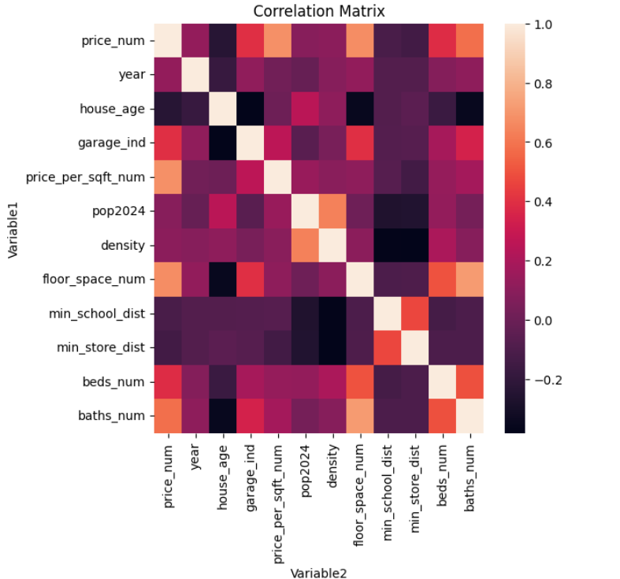
Spatial Data - Exploratory Analysis
Computed correlation
Data imputation
Missing beds_num and baths_num values
Compute floor space range/median for each
populated beds_num and baths_num value
Update missing beds_num and baths_num values
based on floorspace value
Implemented baseline models on dataset
Linear Model: had extreme high mean-square-
error value
Random Forest Regressor: had slightly better but still very high mean-square-error value
Need a more complex model to incorporate the time series element

Slide 5
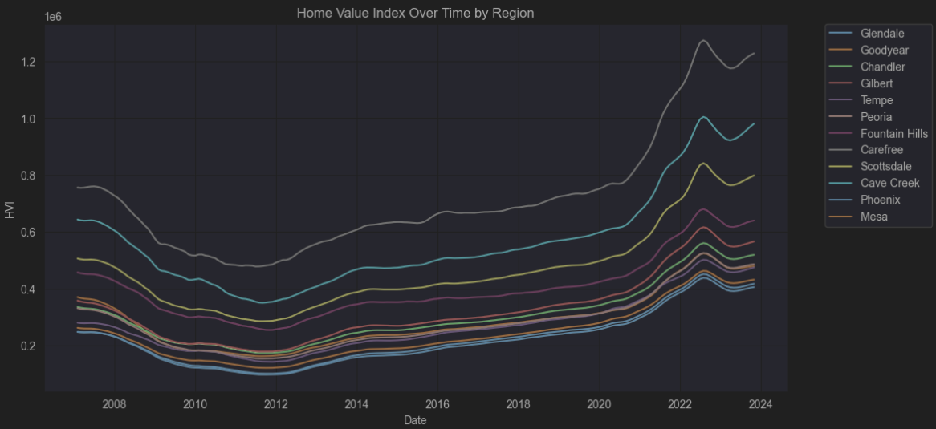
Temporal Data - Exploratory Analysis
Home Value Index vs Date for Cities in Arizona
Data spans Beginning of 2000 to March of 2024

Slide 6
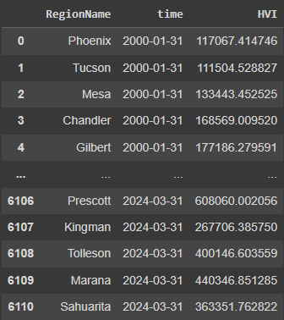
Temporal Data - Exploratory Analysis
Some HVI’s missing from certain cities in early 2000’s
Removed data points with less than 290 entries
Melted original data set to have 3 columns, RegionName, HVI and Date

Slide 7
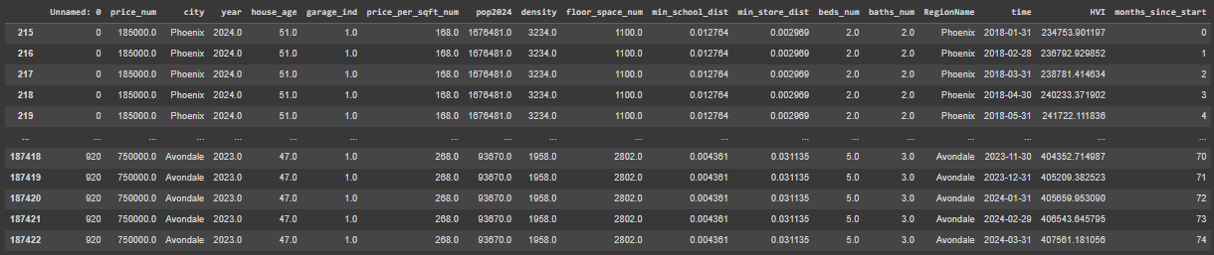
Combination Methodology (Data)
Struggled to combine separate predictions from models (CNN and LSTM)
Solution was to combine data sets
Added spatial data for each time and HVI record from 2018 on
Added months since start as a continuous time variable
Inner join on Spatial.[city] = Temporal.[RegionName]

Slide 8
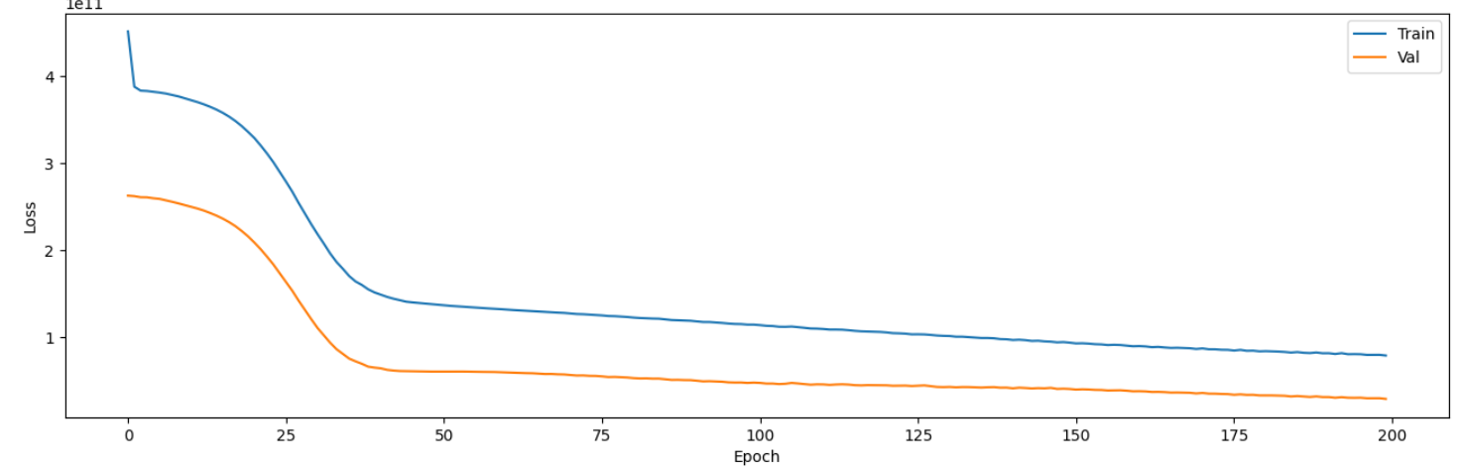
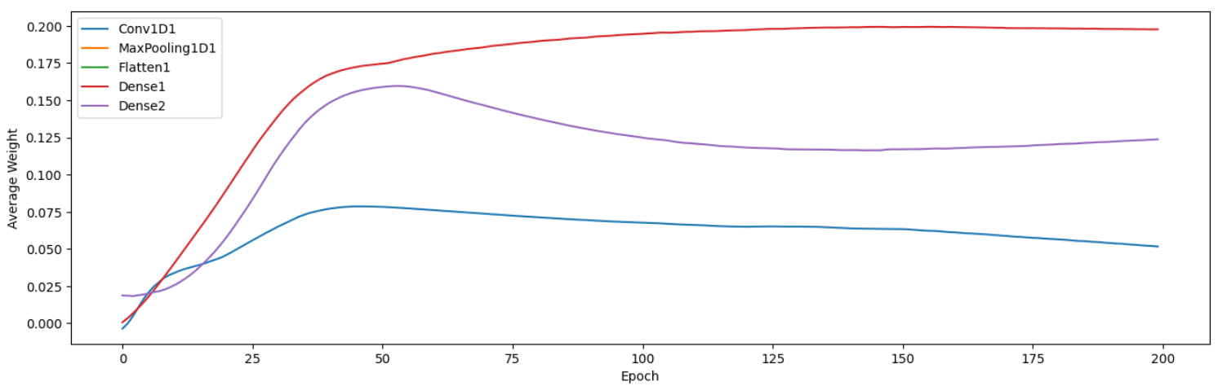
Convolutional Neural Network
One 1D Convolutional Layer
Takes a matrix as input, convolves and transforms data into a single dimension
Additional layers to pool and flatten model
One Hidden Fully Connected Layer
One Fully Connected Output Layer
Mean-Square-Error: $78 trillion +
Loss function plateaus:
Potential underfitting
Weights become stagnant across epochs
Potential vanishing gradient

Slide 9
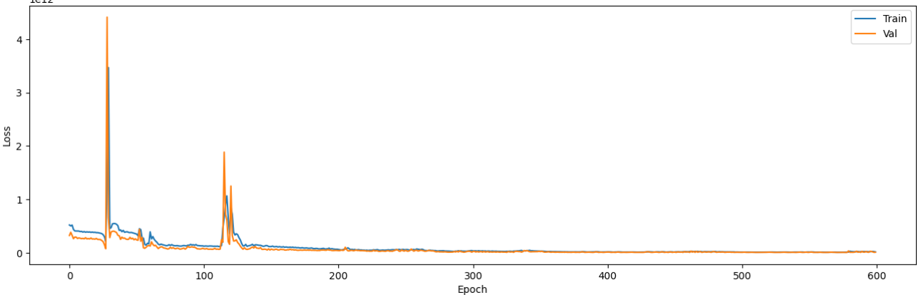
Refining CNN
Tested various hyperparameters for Adam optimizer
Optimal: Learning rate - 0.0005, beta_1 - 0.99, beta_2 - 0.9
Tried adding more hidden layers with multiple different neuron counts
Optimal: # of layers added - 10, # of neurons - 50
Implemented different activation functions with varying parameters
Optimal: function - Leaky ReLU, slope - 0.1
Final mean-square-error value: about $15 trillion

Slide 10
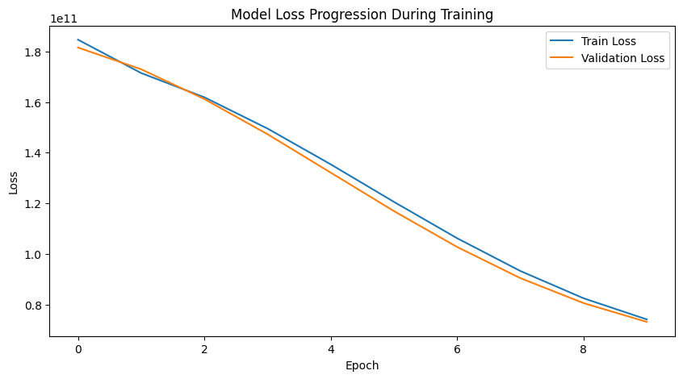
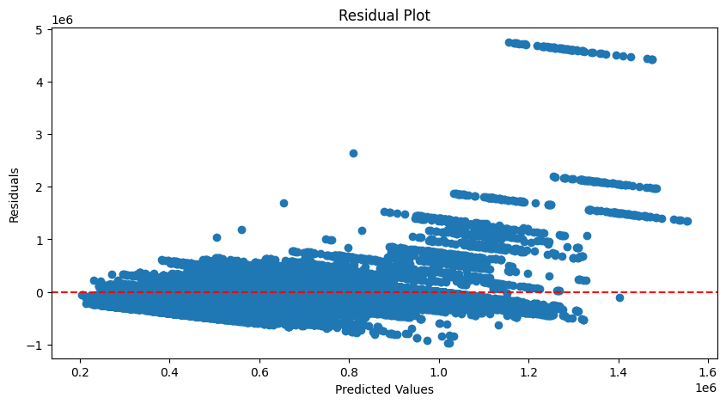
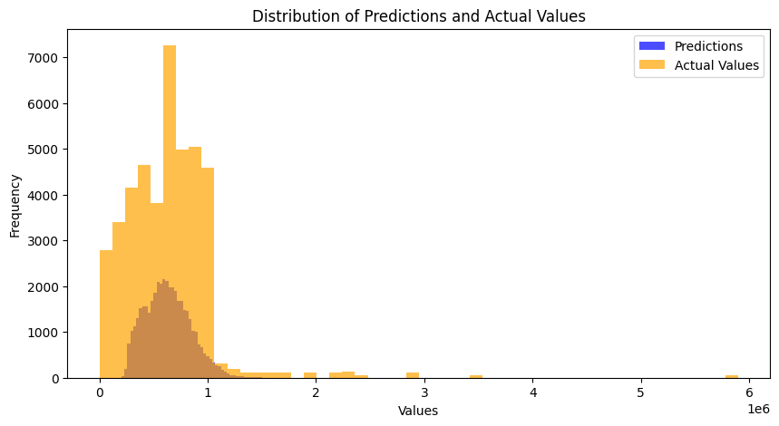
LSTM Neural Network
50 Neurons with Relu Activation
Each time step consists of 1 feature, HVI
Input: sequence of 12 time steps, Target: Most recent 6 months
Loss is continuously decreasing so we can refine model to get lower loss
Residuals show patterns and not tightly clustered, variance increases
Bar graph shows the model has a way to go with predictions (dark orange)

Slide 11
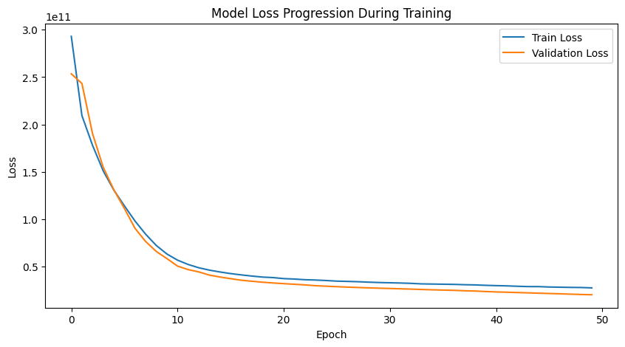
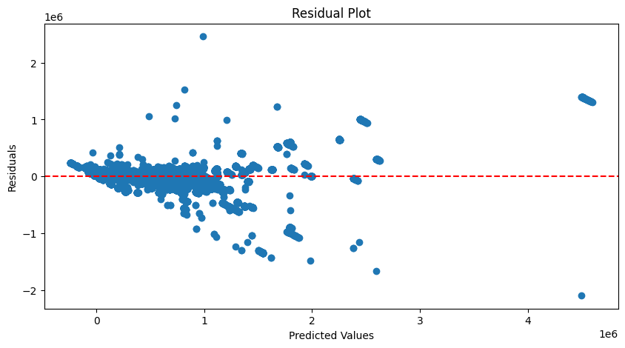
Refining LSTM
Increased neurons to 100 since I have a complex data set
Added dropout to prevent overfitting, training error was significantly lower than validation error
Added dense layer of 256 neurons to allow LSTM to capture more complex relationships in the sequence data

Slide 12
Combined Model
Outputs of CNN and LSTM paths are concatenated to create a combined feature set
Combined features set from both models makes the set robust for prediction tasks involving sequential data
After concatenation the model runs through fully connected “Dense” later with 256 neurons and relu activation
This layer can learn non-linear combinations of our features extracted from previous layers
Another “Dense” layer with a single activation unit and linear activation outputs the final prediction
We use the ADAM optimizer and the custom metric of “avg_diff_metric” to track the average difference of the predicted and actual home prices

Slide 13
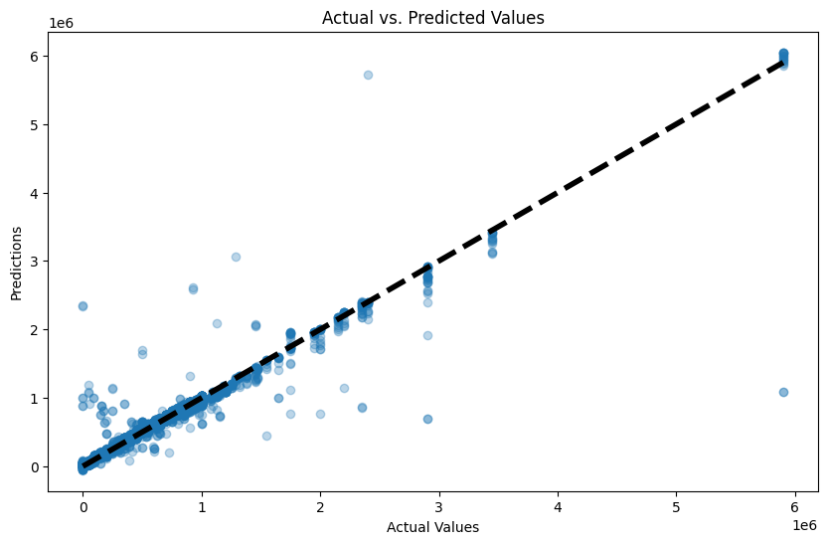
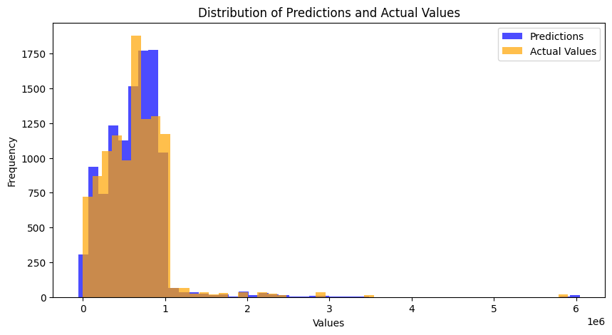
Conclusion pt. 1
Average Difference: 30404.1621
Lower and mid range values are more accurate
Tells us there may be inaccuracies in predicting higher values
The predictions being narrower than the actual around the mode could mean the model is being somewhat conservative
Higher frequency at peak suggests model may be overfitting to a common value

Slide 14
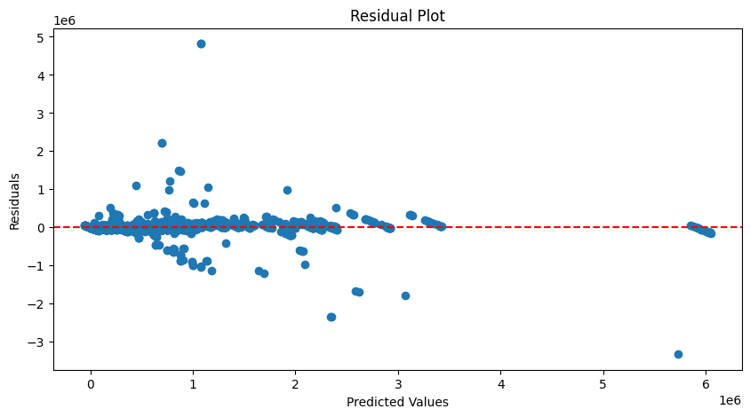
Conclusion pt. 2
Spread in residuals as val increases
tells us the model is less accurate for
higher predictions
To improve accuracy further we could add new data:
Distance to golf course
Change cities to zip codes
Are there HOA dues (boolean)?
House type (Single-Family Home, Condo, Townhouse, Multi Family home, Co-op)
Biggest addition would be adding house price for every time step we have in the temporal data (monthly)
This was not possible with the limited data we had
We could turn this into a tool to predict the direction of price movements (up or down) for houses by using binary classification of trends rather than prices

Slide 15
Spatial and Temporal Data Sources
House listings scraped from https://www.trulia.com from July 2023 to April 2024
Arizona supermarket locations scraped from http://www.supermarketpage.com/state/AZ/
Coordinates obtained from https://www.gps-coordinates.net/gps-coordinates-converter h
Arizona school locations dataset found from https://azgeo-data-hub-agic.hub.arcgis.com/datasets/29abc422fd0541f2b3bbe21d1b16c5f6/explore
Arizona population dataset obtained from https://worldpopulationreview.com/states/cities/arizona
Zillow Home Value Index found from https://www.zillow.com/research/data/

